Slide 1
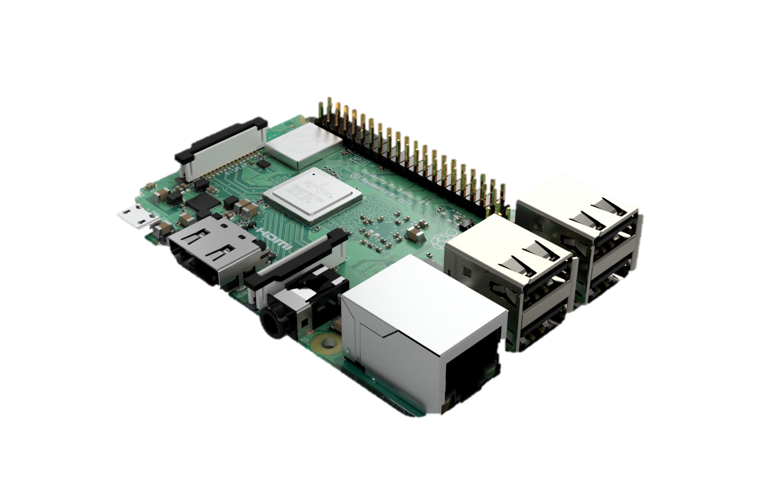
WEB SERVER

Slide 2
Downloads
APACHE WEB SERVER
https://www.raspberrypi.org/documentation/remote-access/web-server/apache.md

Slide 3

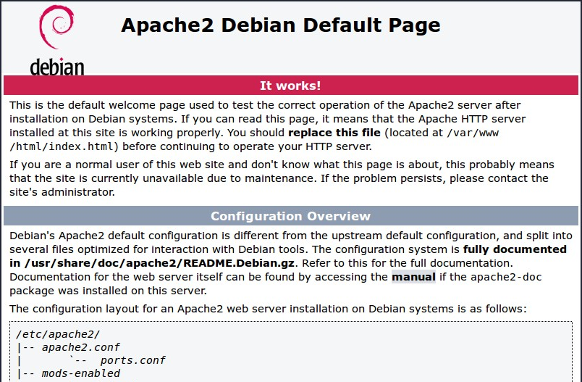
TEST YOUR WEBSERVER
FIND WHAT YOUR PI’S IP ADDRESS IS
hostname -I
YOU SHOULD SEE AN APAPCHE2 DEBIAN DEFAULT WEB PAGE
NOW LET’S GET INTO EDITING THE WEB PAGE!

Slide 4
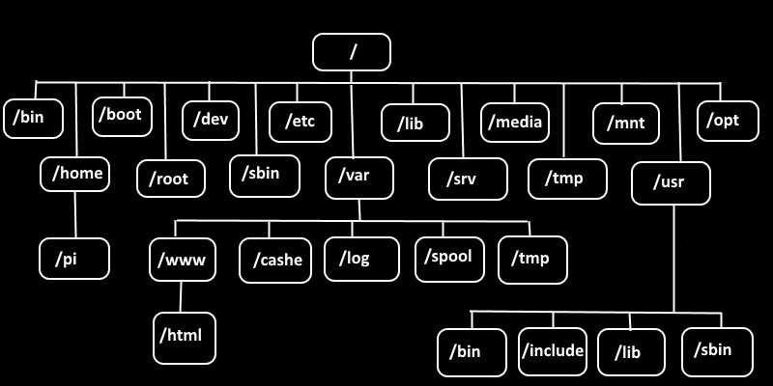
EDITING YOUR WEB PAGE
NAVIGATE TO THE DIRECTORY CONTAINING THE HTML FILE
cd /var/www/html
CHANGE THE OWNERSHIP OF THE FILE TO ALLOW US TO EDIT
sudo chown [USER_NAME]: index.html # “pi” IS DEFAULT USER NAME

Slide 5
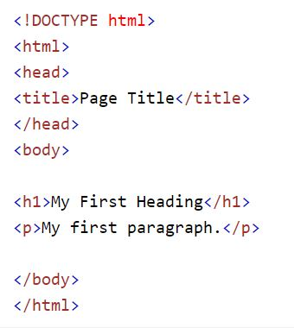
BASIC HTML SYNTAX
GREAT RESOURCE FOR HTML
https://www.w3schools.com/html/default.asp

Slide 6
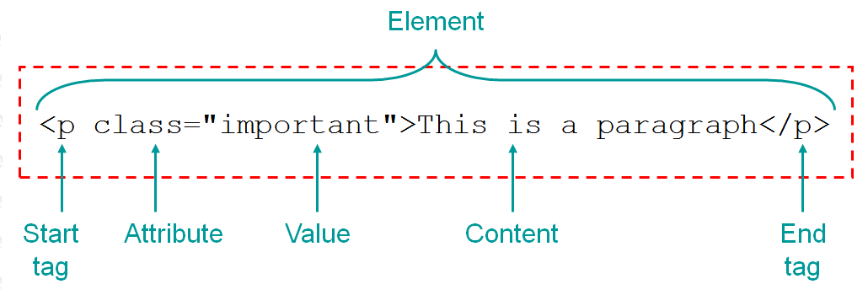
TAGs
<tagname>content goes here...</tagname>
DEFINE HTML HEADINGS
<h1> to <h6>
DEFINE A PARAGRAPH HEADING
<p>

Slide 7
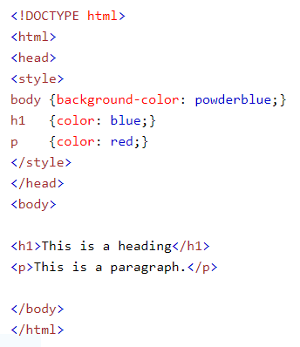
Style attribute
<tagname style=“property:value;“>
PROPERTIES
background-color:color
color:color
font-family:font
font-size:percentage%
text-align:alignment

Slide 8
images
<img src=“url”>
USE THE style ATTRIBUTE WITH width AND height PROPERTIES TO PLAY AROUND WITH IMAGE DIMENSIONS
style=“width:[pixels]px; height:[pixels]px;”

Slide 9
BACKGROUND IMAGE
PUT THE style ATTRIBUTE WITHIN THE body TAG
1
STYLE WILL TAKE IN A property CALLED “background-image” WITH A VALUE CALLED “url”
2
PUT THE URL OF YOUR IMAGE IN PARENTHESIS AFTER url
3
DON’T FORGET A SEMICOLON AFTER YOUR URL AND TO WRAP THE URL INSIDE QUOTATIONS
4

Slide 10
WHY IS MY BACKGROUND REPEATING?
ATTRIBUTES NEEDED
background-repeat
background-size

